Slide 1
NETFLIX DATA ASSESSMENT
Submitted by
BISI DIEKOLA

Slide 2
Analysis Outline
Introduction
Content
Type of shows/movie per year
Movie type per category
Movie per Country
Conclusion/Recommendation

Slide 3
Netflix discovered an upsurge in customers subscription during pandemic, but a drastic drop as months after pandemic period
Covid -19 was declared a pandemic on 11th March, 2020
Analysis of data from the last few years of the to understand the shows/movie customers were watching to improve the service

Slide 4
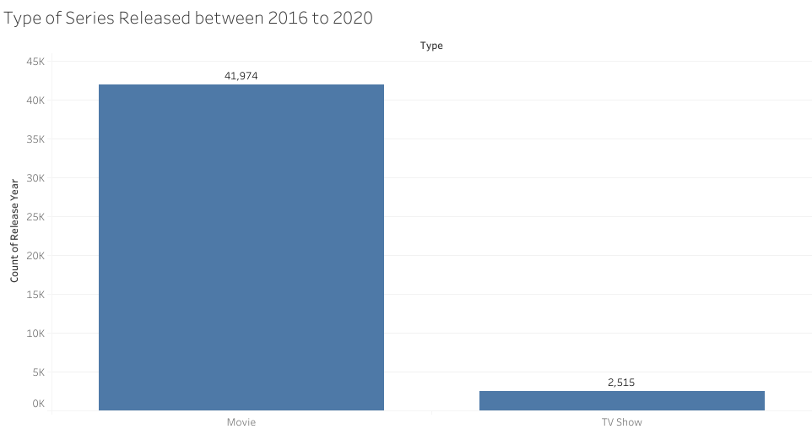
The data shows 41,974 movie was released against Tv show of 2,515 within the year 2016 to 2020 on Netflix

Slide 5
ACTIVITIES RELEASED PER CATEGORY
The bar chat in the next slide, shows that Dramas was the highest category of the activities released on Netflix with 19,463 followed by the international followed by international movie which was 18,908, also comedies was also among the top three with 13,485. Meanwhile, Reality TV had the least with 7

Slide 6
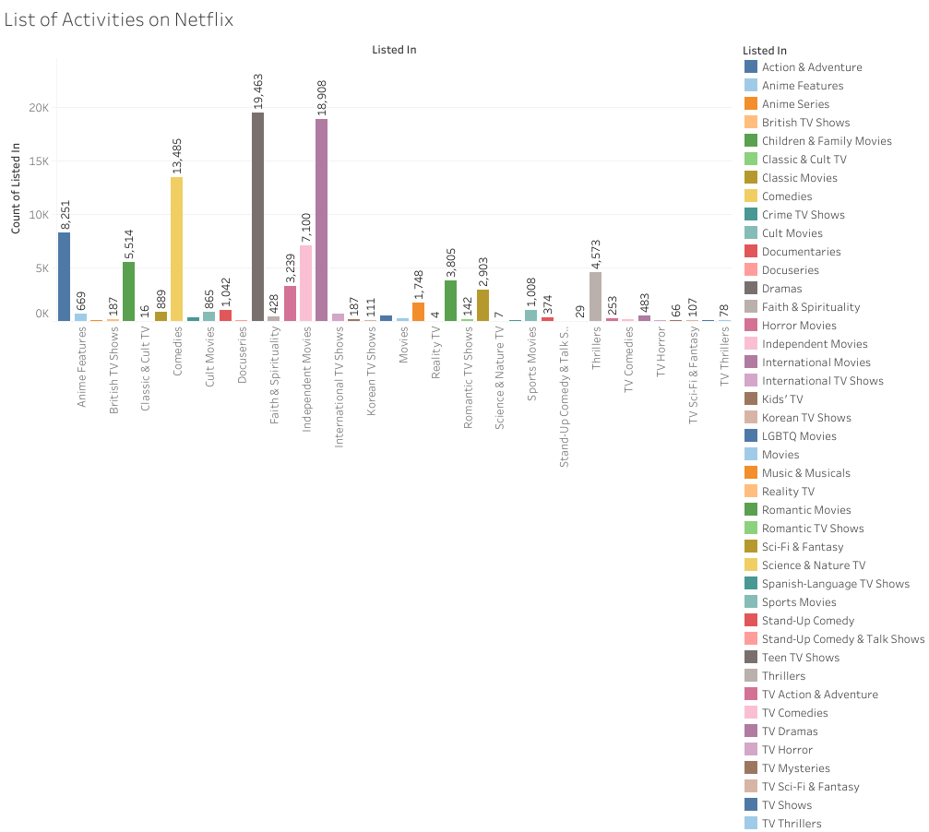

Slide 7
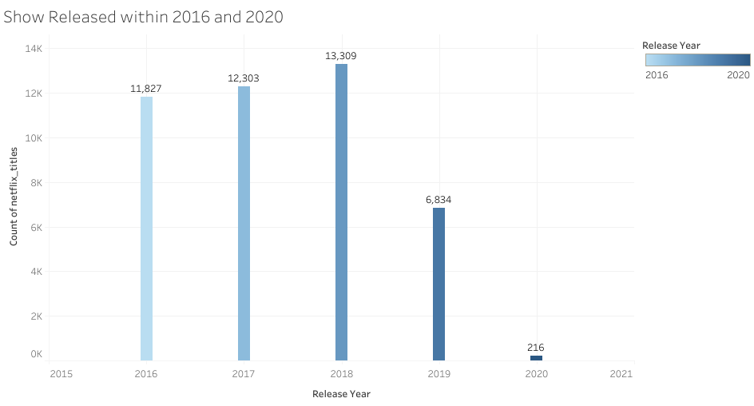
The bar chat shows the show released between 2016 and 2020. it shows highest number of movies was released in 2018 (13,309), followed by 2017 (12,303) and the least between this period was 2020 (216)

Slide 8
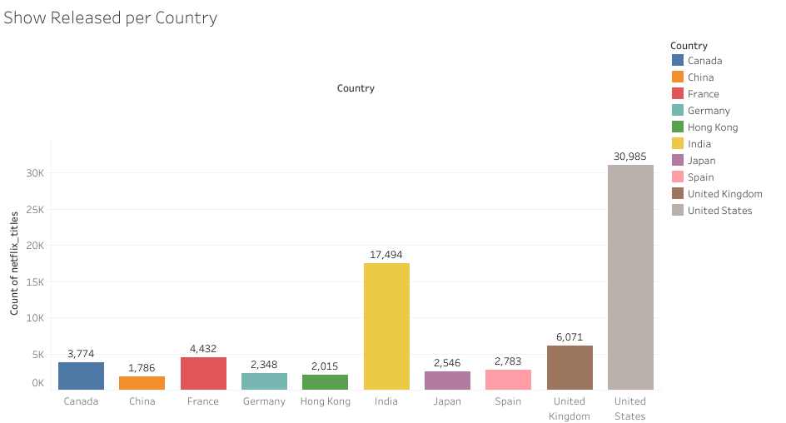
This shows the top 10 country of the movie released. United states has the highest movie released with 30,985 followed by India with 17,494 while china is the 10th on the list with 1,786

Slide 9
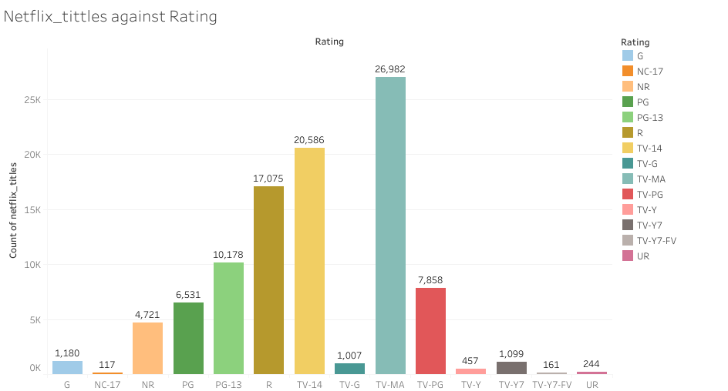
This shows how movie released was rated on Netflix. Highest movie released fell under TV-MA rating (26,982) followed by TV-14 (20,586) and the least was TV-Y7-FV (161).

Slide 10
CONCLUSION AND RECOMMENDATION
Since subscribers are more interested in Movies compare to TV shows, hence more movies should be released to increase the subscription rate.
It has been established that Dramas, International Movies and comedies are the highest categories of activities released on Netflix, more activities in the aforementioned categories is highly recommended.
From the data, it is deduced that United state, India and China top the country with highest number of movie released, it is advised that there should be a reasonable increase in the movie released across the country and there should be a priority for United State, India and China.
More movies/shows with ratings of TV‐MA, TV‐14, TV–PG should be produced as this caters to majority of the audience/Subscribers choice

